Slide 1
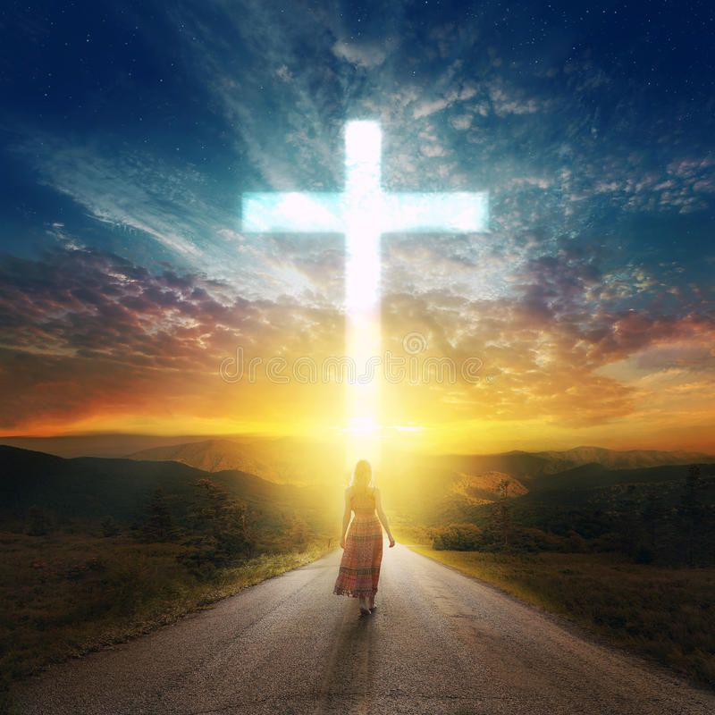
Welcome
to
Beech Grove Church
SUNDAY,
NOVEMBER 2, 2025
What Do I Live For Now?

Slide 2
Beech Grove Mission Statement OUR BEECH GROVE CHURCH IS A FAMILY THAT LIVES BY FAITH, IS KNOWN BY LOVE, AND IS A VOICE OF HOPE. Beech Grove Vision Statement OUR BEECH GROVE FAMILY FOCUS IS TO GUIDE PEOPLE WITH GOD’S WORD TOWARD A CLOSER RELATIONSHIP WITH HIM.

Slide 3

Visitor’s First Time Here? If so, we want to meet you! Please fill out a visitor card in the pews and drop in the offering plate. We have a welcome packet available in the foyer for you to take home. We are glad you are here today! THANK YOU FOR VISITING WITH US TODAY!
FIRST TIME
HERE?
CALLING
ALL
VISITORS!!

Slide 4

Today After Church: Church Board Meeting

Slide 5

DARTBALL 3rd GAME MONDAY, NOVEMBER 3 7:30 at Ft. Jefferson

Slide 6
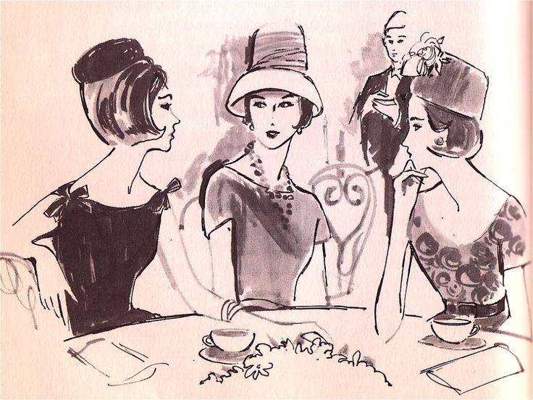
Thurs. November 13th Woman’s lunch At Montage At 12:30

Slide 7
Thurs. November 13th Woman’s lunch At Montage At 12:30

Slide 8
SAVE THE DATES: Saturday, November 15th Church Board Retreat Sunday, November 16th Friendsgiving carry-in meal Wednesday, December 24th Candle Light Service @ 7:00

Slide 9

Faye Ary and care givers Annie Martin Jerry Nester Judy Puterbaugh and care givers Karen Troutwine Diane Freeman Randy Devor Board Meeting Praise Report: Jim Schwartz

Slide 10

Operation Christmas Child boxes are ready! A box of extra items is available to for taking next to the Shoeboxes. Take one or more and get started. “Back to school sales are in progress. This is the best time to purchase school supplies for in your shoeboxes . Extra copies of a full list of suggested gifts are available.

Slide 11
What Do I Live For Now?

